Slide 1
Social Data Science Lesson #2
Rasmus W. Schmøkel, University of Southern Denmark
Fall 2022

Slide 2
Overview
Lesson #1 - Introduction to the course & Data Science as a field
Lesson #2 - Programming Fundamentals
Lesson #3 - Data Science Fundamentals
Lesson #4 - Working with API’s
Lesson #5 - Network Analysis
Lesson #6 - Webscraping in R
Lesson #7 - Text as data: Who say’s what?
Lesson #8 - Machine Learning 1
Lesson #9 - Machine Learning 2
Lesson #10 - Machine Learning 3 & finale remarks

Slide 3
Today’s lesson
Last time
Common data types
Control flow
Iterations
Functions

Slide 4
Last time What is Data Science?
Domain Knowledge
Computer Science (programming skills)
Statistics

Slide 5
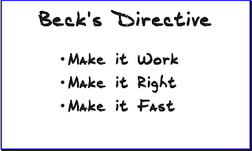
Programming principles
DRY vs WET code

Slide 6
Programming Principles
Don’t
Repeat
Yourself
Write
Everything
Twice

Slide 7
Data types in R

Slide 8
Common data types Primitive types
12
Integer
1.54
Double/float
06-10-1998
Date
06-10-1998 10:12:56:98
Timestamp
Datetime
“Hello World”
String
TRUE
Logical/Boolean

Slide 9
Common data types Primitive types
12
Integer
1.54
Double/float
“Hello World”
String
TRUE
Logical/Boolean
Gender
Factor
Integer levels
String

Slide 10
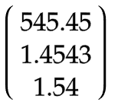
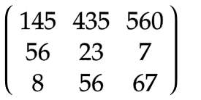
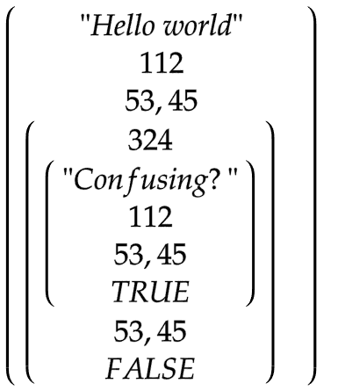
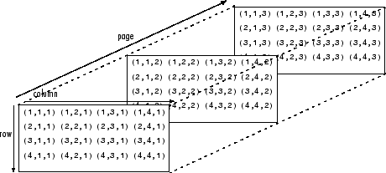
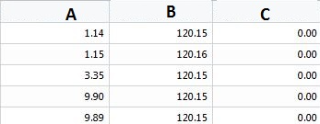
Common data types Complex types
Vector
List
Matrix
Array
Data frame
Fig. B
Fig. A
Fig. E
Fig. C
Fig. D
Notes:
Briefly, and with some details left out:
A vector is what is called an array in all other programming languages except R — a collection of cells with a fixed size where all cells hold the same type (integers or characters or reals or whatever).
A list can hold items of different types and the list size can be increased on the fly. List contents can be accessed either by index (like mylist[[1]]) or by name (like mylist$age).
A matrix is a two-dimensional vector (fixed size, all cell types the same).
An array is a vector with one or more dimensions. So, an array with one dimension is (almost) the same as a vector. An array with two dimensions is (almost) the same as a matrix. An array with three or more dimensions is an n-dimensional array.
A data frame is called a table in most languages. Each column holds the same type, and the columns can have header names.

Slide 11
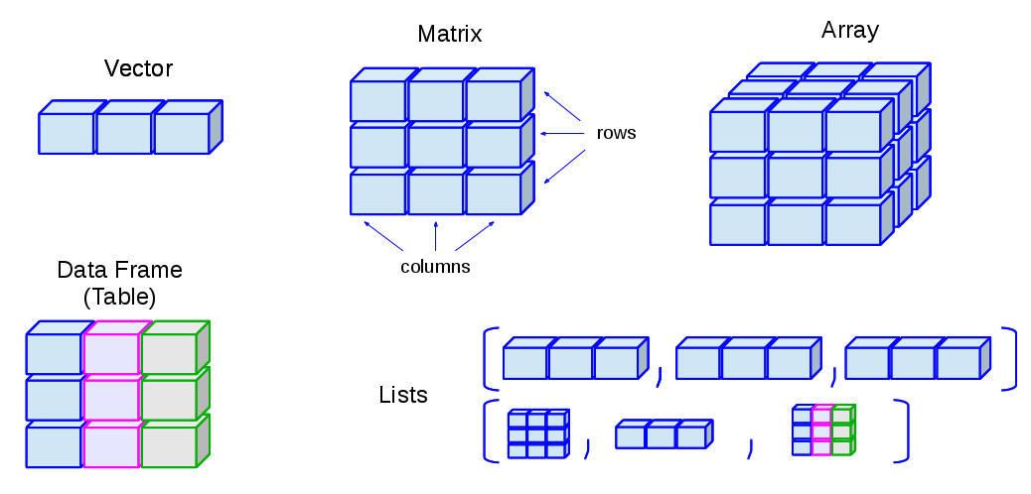
Common data types Complex types
Notes:
Vectors: one-dimensional arrays used to store collection data of the same mode
Numeric Vectors (mode: numeric)
Complex Vectors (mode: complex)
Logical Vectors (model: logical)
Character Vector or text strings (mode: character)
Matrices: two-dimensional arrays to store collections of data of the same mode. They are accessed by two integer indices.
Arrays: similar to matrices but they can be multi-dimensional (more than two dimensions)
Factors: vectors of categorical variables designed to group the components of another vector with the same size
Lists: ordered collection of objects, where the elements can be of different types
Data Frames: generalization of matrices where different columns can store different mode data.

Slide 12
Control Flow

Slide 13
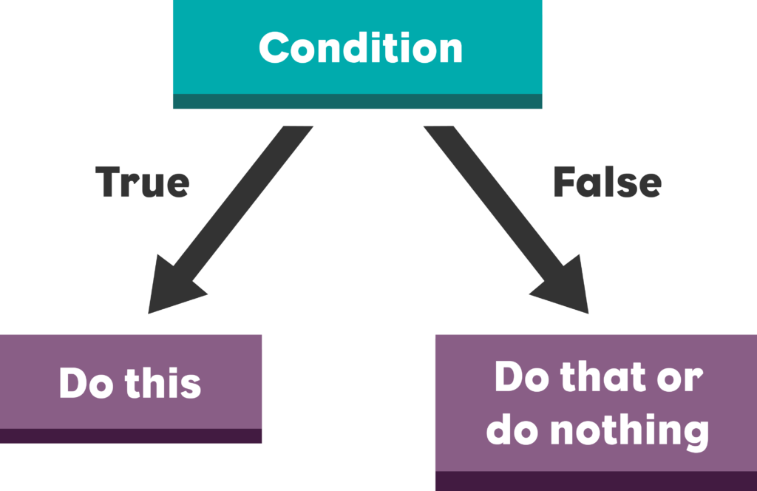
Control flow Control statements Conditionals

Slide 14
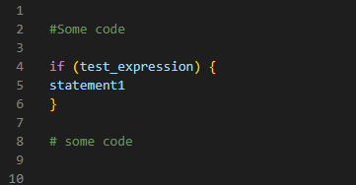

Control flow Syntax

Slide 15
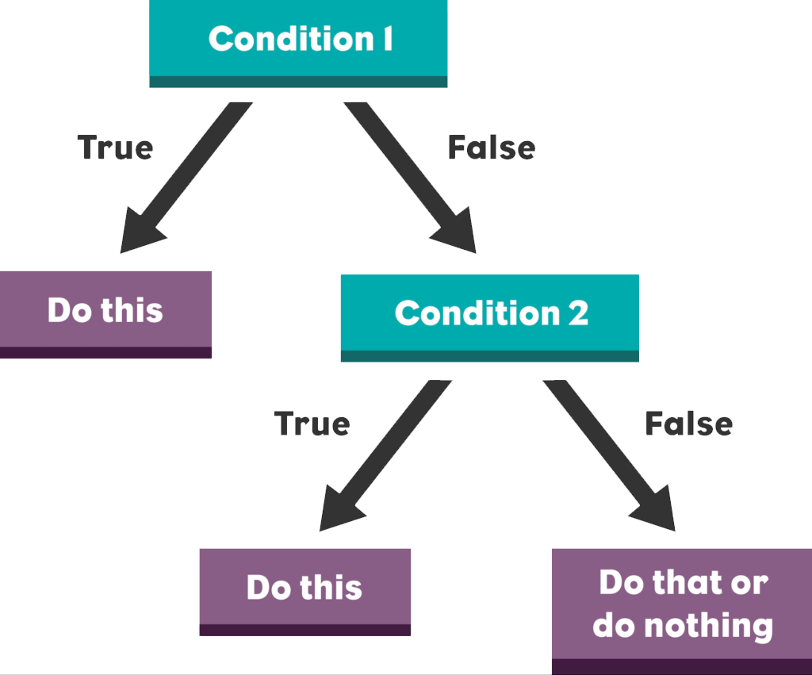
Control flow

Slide 16
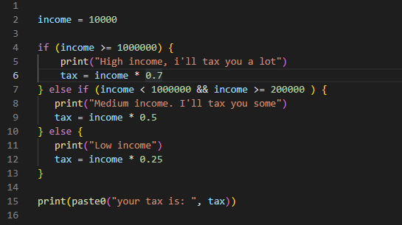
Control flow

Slide 17
Iteration

Slide 18
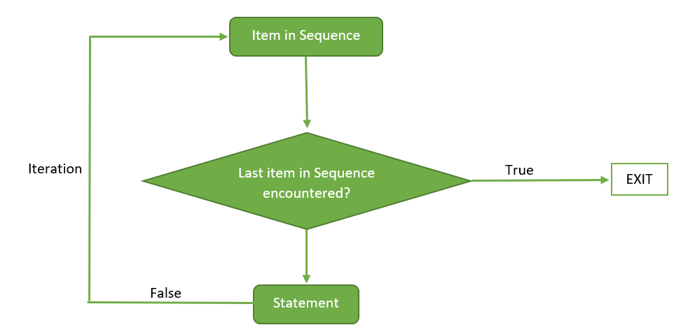
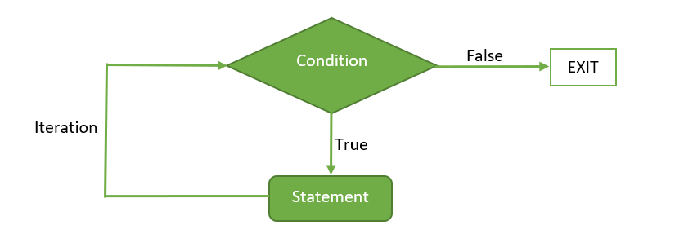
Iteration
For loop
While loop

Slide 19
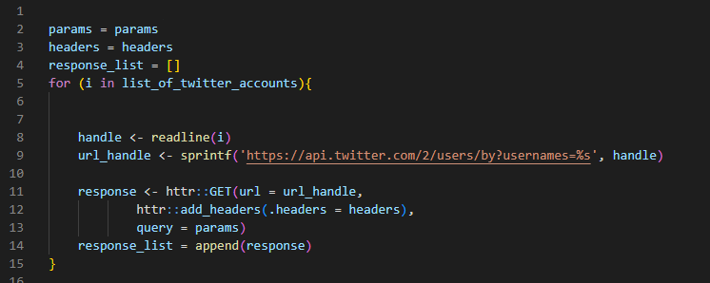
For loop Example with pseudo code

Slide 20
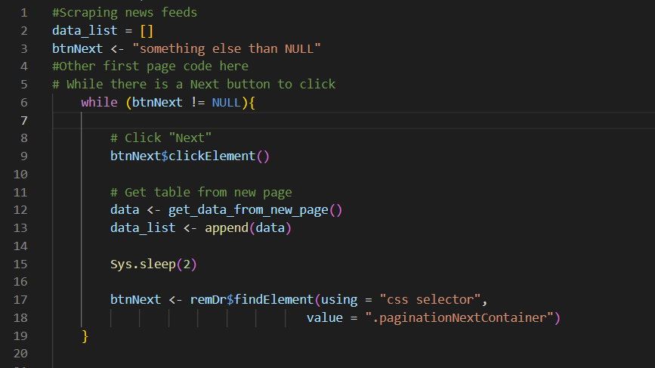
While loop Example with pseudo code

Slide 21
Functions
Notes:
Feedforward til course i 2023:
Forklar mere om scope I funktioner fx hvordan args er den eneste “indgang” ind til funktionen. Kan ikke bruge argumenter udenfor.

Slide 22
Functions
Less work! - avoiding repetitive coding
Less error prone
Easier to maintain
Easier to debug
.. Often also faster!

Slide 23
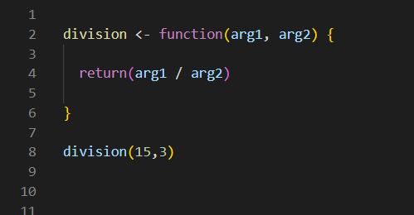
Functions

Slide 24
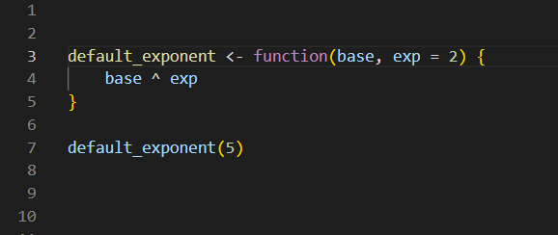
Functions

Slide 25
Lab time!

Slide 26
Lab#2 goals
Go through the lab#2 R-notebook

